Slide 1
dead character

Slide 2
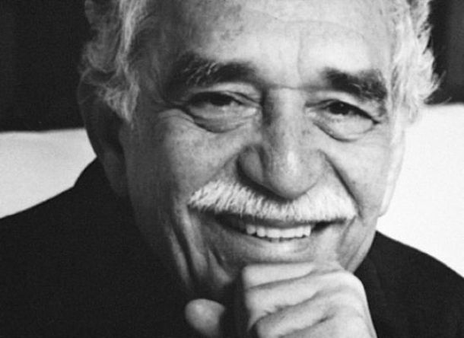
GABRIEL GARICIA MARQUEZ

Slide 3
Date of birth: March 6, 1927, Aracataca
Date of death: April 17, 2014, Mexico City, Mexico

Slide 4
Occupation :
Writer
Journalist
Editor.

Slide 5
Gender :
novel
story
chronicle
reportage

Slide 6
Awards Nobel Prize for Literature (1982)

Slide 7
THANK YOU VERY MUCH

